Slide 1
DEVWorld Conference - Amsterdam, 2024
Cultural Relativism:
A Prism for Constructing Cross Cultural Communities
Claude N. Warren, Jr.
Notes:
The opinions expressed in this talk are mine and do not necessarily reflect the views of my employer, projects I work on, or this conference. In the course of this talk there may be images or phrases that offend. Any such offence is from a lack of knowledge on my part and is unintentional.

Slide 2



Claude Warren
Member of Apache Foundation
Member and leader of cross cultural teams.
Not in Wikipedia – that is my father.
Grew up in a framework of cultural relativism
https://www.linkedin.com/in/claudewarren
https://github.com/Claudenw
https://www.researchgate.net/profile/Claude_Warren_Jr
Notes:
Father and Mother students at North Western University where they became immersed in the theory and practice of cultural relativism.
They were students of Melville Herskovitz, who was himself a student of Franz Boas whom we will get to in a moment.
Suffice it to say that both of my parents were Cultural Relativists.
So let’s start by defining culture.

Slide 3
Culture
Learned behavior, a learned social framework.
Notes:
People learn culture from their family, their friends, school, city, state, province, country, employment, activities, anywhere that people gather a culture develops.

Slide 4

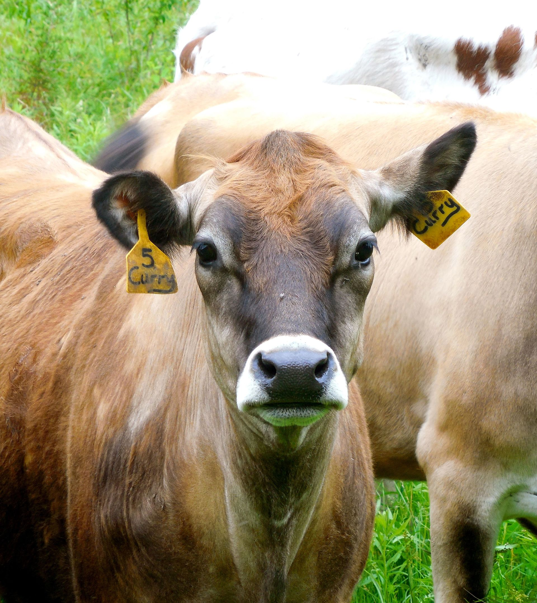
Culture
Learned behavior, a learned social framework.
Not that you eat, but what you eat.
Notes:
Durian fruit comes from SE Asia
Signs in Singapore mass transit terminals prohibit bringing the fruit into the station or on the vehicles.
Acquired taste – I couldn’t
Smells like rotting flesh
Cow sacred in Hinduism
Now, let’s look at culturally determined perception

Slide 5

Culture
Learned behavior, a learned social framework.
Not that you eat, but what you eat.
Not that you perceive time, but how you perceive it.
Notes:
To the Amara people in the Andes, past for several generations llies in front and the future behind, beyond 7 or so generations time travels farther back as you go left to right.
So the Amara face the past, not the future. To us Back to the future is an interesting play on words and a movie title, for the Amara, it is the normal way to perceive time.
The Amara do not go forward to the future, and anyone cajoling them to do so would sound just as silly as someone telling us to to backwards to the future.
Now that we have an understanding of what culture is let us look at cultural relativism

Slide 6
Cultural Relativism
The idea that beliefs and practices can only be understood from the point of view of the culture that surrounds them.
Notes:
Separate from Moral Relativism.
Has been used to make arguments for the continuation of human rights offenses on the grounds they are part of the culture.
In Anthropology cultural relativism means trying to get outside of your cultural biases to understand others.
In managing cross cultural teams, Cultural Relativism is the prism through which we will discover miscommunication and discuss interactions between members.

Slide 7
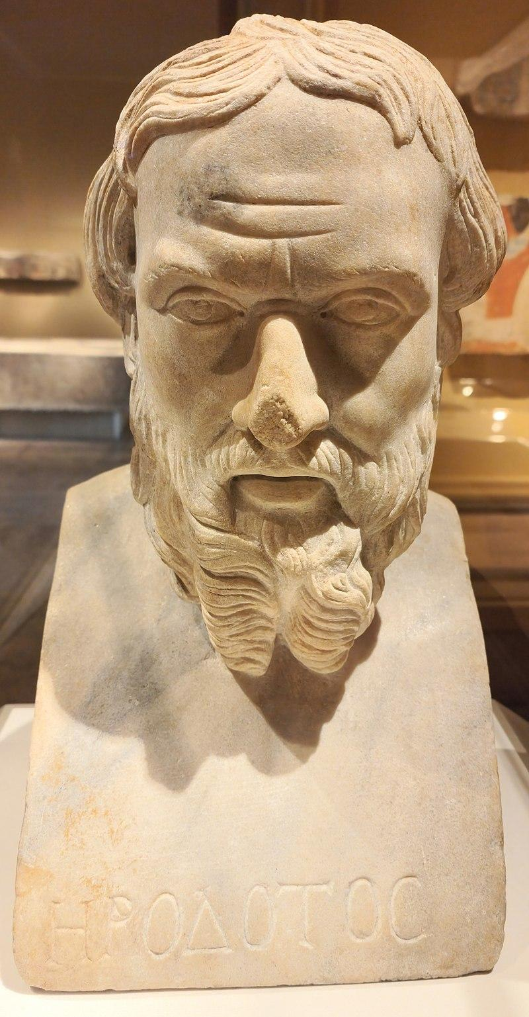
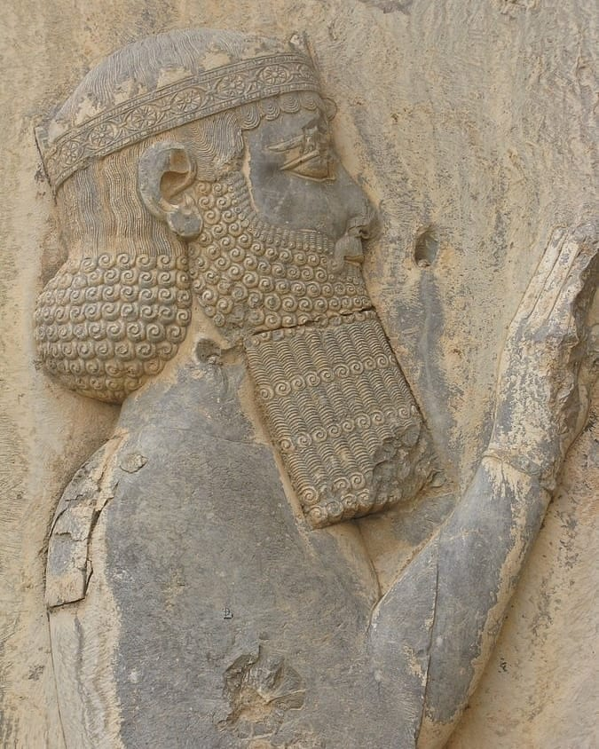
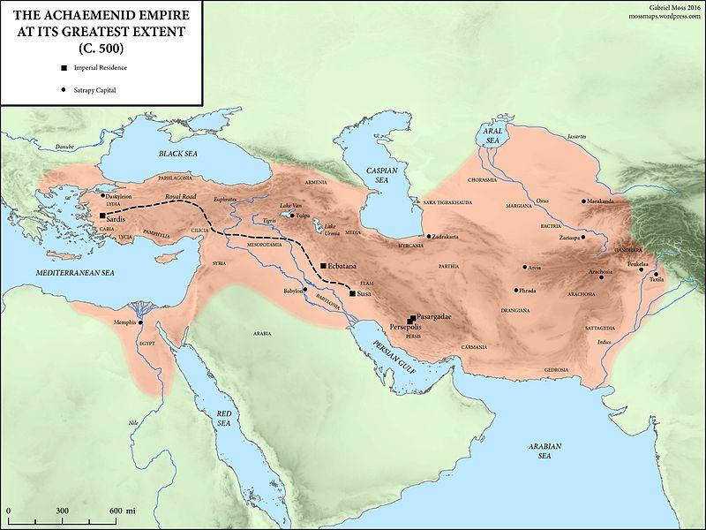
Cultural Relativism
The idea that beliefs and practices can only be understood from the point of view of the culture that surrounds them.
First record as concept : Herodotus wrote about Darius the Great’s inquiry into funeral customs.
Notes:
CR was first recorded as a concept by Herodotus, Greek historian 484 to 425 BCE.
Darius the Great, a Persian ruler who reigned from 522 to 486 BCE.
Darius inquired about funerary customs on the eastern and western fringes of his empire.
East - funerary cannibalism
West – cremation
When told of the other custom they were each “dismayed and abhorred” by the others practise.

Slide 8
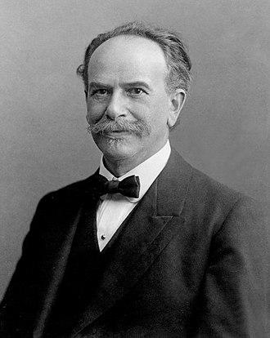
Cultural Relativism
The idea that beliefs and practices can only be understood from the point of view of the culture that surrounds them.
First record as concept : Herodotus wrote about Darius the Great’s inquiry into funeral customs.
Established as axiomatic in anthropology by Franz Boas in the early 20th century.
Notes:
Franz Boas was appointed professor of anthropology at Columbia University in 1899. Many of his students went on to found anthropology departments and research programmes inspired by his work. Boas has been called the "Father of American Anthropology"
Boas first articulated the idea in 1887: "civilization is not something absolute, but ... is relative, and ... our ideas and conceptions are true only so far as our civilization goes".[2] However, Boas did not coin the term.

Slide 9
Cultural Relativism
The idea that beliefs and practices can only be understood from the point of view of the culture that surrounds them.
First record as concept : Herodotus wrote about Darius the Great’s inquiry into funeral customs.
Established as axiomatic in anthropology by Franz Boas in the early 20th century.
First recorded use: Alain Lock, 1924 to describe Robert Lowie’s “extreme cultural relativism” in a review of Lowie’s 1917 book Culture and Ethnology.
Notes:
Alain Lock, was an american writer, philosopher, educator, and patron of the arts. Distinguished in 1907 as the first African-American Rhodes Scholar.
Robert Lowie was a student of Franz Boas and emphasized cultural relativism and opposed to the cultural evolutionism of the Victorian era.
So why do we care about cultural relativism?

Slide 10
Cultural Relativism – Why do we care?
The tools developed by Anthropologists and Ethnographers will allow us to find the friction points between cultures in our cross cultural teams.

Slide 11
Cultural Relativism – Why do we care?
The tools developed by Anthropologists and Ethnographers will allow us to find the friction points between cultures in our cross cultural teams.
Friction points lead to misunderstandings.

Slide 12
Cultural Relativism – Why do we care?
The tools developed by Anthropologists and Ethnographers will allow us to find the friction points between cultures in our cross cultural teams.
Friction points lead to misunderstandings.
  Cause cohesive breakdown in the team.
Notes:
Members begin to think that other members are working against them – sabotaging their efforts.

Slide 13
Cultural Relativism – Why do we care?
The tools developed by Anthropologists and Ethnographers will allow us to find the friction points between cultures in our cross cultural teams.
Friction points lead to misunderstandings.
  Cause cohesive breakdown in the team.
  Cause misunderstanding of work assignments.
Notes:
Wrong work items being developed

Slide 14
Cultural Relativism – Why do we care?
The tools developed by Anthropologists and Ethnographers will allow us to find the friction points between cultures in our cross cultural teams.
Friction points lead to misunderstandings.
  Cause cohesive breakdown in the team.
  Cause misunderstanding of work assignments.
  Cause failure to deliver the correct work product.
Notes:
Let’s look at a couple of examples of Cultural Relativism in action.

Slide 15

Cultural Relativism – Example 1
With the exception of people with colour vision deficiencies, everybody perceives colour the same way.
Notes:
Some languages have no word for the color green, using instead the term for yellow or blue. So for cultures with those languages the stoplight may have only 2 colors and the phrase “go on green” makes no sense.
In Irish the color of a person is their hair color not their skin color.
In Irish the term for a person of color is “blue”. So the translation of “Black lives matter” and “Blue lives matter” are the same and so a distinction so strong in US culture is lost in translation.

Slide 16
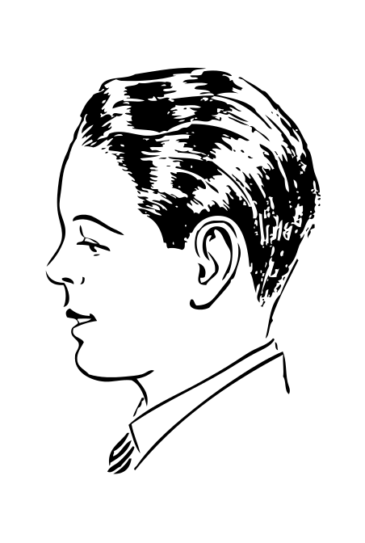

Cultural Relativism – Example 2
just about
Notes:
Icons, phrases and gestures are all culturally centered.

Slide 17
Cultural Relativism – Example 2
just about
Notes:
The thumbs up symbol generally means OK, all good, proceed, or similar approval. However, in some cultures it is a rude gesture. In ancient Rome it was, contrary to popular belief, the signal to put the gladiator to death. In addition, its use in online forums has begun to modify the meaning in western culture from approval, to a passive-aggressive way to shut down a conversation. All of this indicates that the meanings of symbols drift over time and space.
I moved from the US to Ireland about 10 years ago and discovered that they are two countries separated by a common language. For example the phrase “just about” as in “I just about caught the bus” was tripping me up. In the US “I just about caught the bus” means I almost got on the bus but just missed it. In Ireland it means I almost missed the bus but managed to get on it. They describe the opposite outcomes of the same event.
Idioms are another good source of misunderstandings, phrases like “There is more than one way to skin a cat”, meaning there is more than one solution, may be perfectly acceptable from within your cultural reference, but there are situations where it may be offensive or misunderstood.
In general we think of a nodding head as meaning “yes”. However in Bulgarian culture it means “no” while shaking the head from side to side means “yes”.
In some cultures it is appropriate to interject a short word into other speakers exposition to indicate you are listening. In English this can be seen where some people say “yes” at the end of a speakers sentence. The BBC Television show “Antiques Roadshow” is filled with examples of this type of interaction. However, in other cultures it is considered rude to interrupt the speaker.

Slide 18

Cultural Relativism – Example 3
Notes:
Finally, there are words and phrases that are unacceptable in certain cultures. There are symbols and phrases that were I to use them would probably get me reported for violation of the code of conduct and derail this entire conversation, but yet these words and phrases are acceptable in other cultural settings.
Cultural Relativism teaches that when in a multicultural setting, if one is confused or triggered by a symbol, gesture, or phrase, one should ask what it means.

Slide 19
Cultural Relativism -- Summary
"Judgements are based on experience, and experience is interpreted by each individual in terms of his own enculturation."
-- Melville Herskovits
Notes:
Melville Herskovits was a student Franz Boas.
In 1948, he founded the first major interdisciplinary American program in African studies at Northwestern University. Both my parents were students of his.
Before we look at a few examples of cultural relativism in cross cultural teams, I want to emphasize that I come from a western background. I have almost always worked for western companies and when not working for western companies I was supporting western clients and their expectations. So my examples come from a western perspective. I do not know any other perspective, but I expect that there are other solutions to these problems can come from other perspectives. The solutions presented here are not THE way to solve the issues, but A way that worked in a western centered client experience. The important thing is the tools that were used to discover the issues so that we could arrive at solutions.

Slide 20
Cross Cultural Teams – Example 1
Project to transition development from one team (culture) to another.
In the culture of the receiving team it was not permissible to show failure. This was perceived as a career limiting move.
In the culture of the receiving team it was not acceptable to disagree with someone perceived to be of higher rank.
Notes:
Major issue is that new team did not want to do any work in public.
In order to counter these issues the team...

Slide 21
Cross Cultural Teams – What is the problem
The fear of failure lead the development team
  to avoid the source code repository.
  to avoid talking about any issues they had with the assignments.
The inability to disagree lead the development team to avoid conflict.
  they would not state that a date was unreasonable or unobtainable.
  when management forgot about a local holiday the team just worked through it assuming that was what mgmt wanted.
Notes:
Potential code loss
Failure to talk leads to:
miscommunication
missed opportunities to learn the code base
missed opportunities to improve the solution.
In other cases I have seen dev teams say “Ok” when ever a request was made. The management team heard “they agree with the request” the dev team meant “I hared what you asked for.” The proposed solution was to have the management team make one unreasonable request every session and the dev team had to figure out which one was unreasonable and refuse it.

Slide 22
Cross Cultural Teams – Example 1, Solution
Made it safe to fail and exhibited failures from original team.
Notes:
Exhibited failure by...

Slide 23
Cross Cultural Teams – Example 1, Solution
Made it safe to fail and exhibited failures from original team.
  Pointed out that nobody would look at failed jobs unless asked.

Slide 24
Cross Cultural Teams – Example 1, Solution
Made it safe to fail and exhibited failures from original team.
  Pointed out that nobody would look at failed jobs unless asked.
  Developers were not allowed to change main branch code
Notes:
Ability to change the main branch was a defect in the controls and any developer able to do so should be credited with discovering a bug.

Slide 25
Cross Cultural Teams – Example 1, Solution
Made it safe to fail and exhibited failures from original team.
  Pointed out that nobody would look at failed jobs unless asked.
  Developers were not allowed to change main branch code
  All developers follow the same process.

Slide 26
Cross Cultural Teams – Example 1, Solution
Made it safe to fail and exhibited failures from original team.
  Pointed out that nobody would look at failed jobs unless asked.
  Developers were not allowed to change main branch code
  All developers follow the same process.
  No code would be reviewed or discussed unless it was in the version control system.
Notes:
Added benefit of ensuring all code was in version control in case of a laptop or desktop failure.

Slide 27
Cross Cultural Teams – Example 1, Solution
Made it safe to fail and exhibited failures from original team.
  Pointed out that nobody would look at failed jobs unless asked.
  Developers were not allowed to change main branch code
  All developers follow the same process.
  No code would be reviewed or discussed unless it was in the version control system.
Made it safe to disagree

Slide 28
Cross Cultural Teams – Example 1, Solution
Made it safe to fail and exhibited failures from original team.
  Pointed out that nobody would look at failed jobs unless asked.
  Developers were not allowed to change main branch code
  All developers follow the same process.
  No code would be reviewed or discussed unless it was in the version control system.
Made it safe to disagree
  Daily stand-ups were introduced in which discussion and dissent was encouraged.
Notes:
An anathema to agile purists, new members slowly began to open up, disagree, ask questions, and make strong contributions to the project.

Slide 29
Cross Cultural Teams – Example 1, Solution
Made it safe to fail and exhibited failures from original team.
  Pointed out that nobody would look at failed jobs unless asked.
  Developers were not allowed to change main branch code
  All developers follow the same process.
  No code would be reviewed or discussed unless it was in the version control system.
Made it safe to disagree
  Daily stand-ups were introduced in which discussion and dissent was encouraged.
  “Indelicate” questions were not discouraged.
Notes:
In order for participatory communication to exist, it must be safe to ask the questions that are not “OK” in terms of the culture.
Net result was we established a project culture.
Not your culture is wrong and my culture is right but.
The culture of this project is …

Slide 30
Cross Cultural Teams – Example 2
All cultural team members are from “Western” cultures. This conversation occurred on Slack:
2:15 Claude Warren The schedule (without registering) does not give daily start/end times. Can someone tell me what is the start time on the 3rd (doors open) and what is the end time on the 6th (expected end of last presentation) and or doors close?
2:15 <redacted1> @Claude Warren the TALK SCHEDULE with timings are available here — https://app.expopass.com/events/QXRRx0X/schedule
2:18 <redacted2> Welcome keynotes start at 9. First breakout starts at 11:20. Final session ends at 17:40. BOFs start at 17:50
2:19 Claude Warren Thx
2:26 Claude Warren @<redacted1> that link only works if you are registered.
2:27 <redacted3> Sorry, for sanity's sake, we are only managing times on one schedule
2:27 <redacted2> @Claude Warren If you're not registered, why do you care?

Slide 31
Cross Cultural Teams – Example 2, Analysis
To me, they are people I have worked with for a long time.
Notes:
Stress of upcoming conference. Under a lot of pressure to get things done before the end of day.
In the text medium there no vocal or facial clues. While those cluse are culturally based, we were all from the same or at least highly similar cultures.

Slide 32
Cross Cultural Teams – Example 2, Analysis
To me, they are people I have worked with for a long time.
It would just take too long to say:
"I don't see why anyone who is not attending would be interested in the start/end times. Can you elaborate on why you want to know?"
Notes:
So let’s look at how to succeed

Slide 33
How to Succeed
Define the culture of the project, not just words but actions.

Slide 34
How to Succeed
Define the culture of the project, not just words but actions.
  Inclusivity / Sensitivity
Notes:
Training tells you what to do.
Practice is the execution of the training.
Practise builds the culture.

Slide 35
How to Succeed
Define the culture of the project, not just words but actions.
  Inclusivity / Sensitivity
  Consider cultural differences in:
    Discussions
    Planning
    Use case definitions
    Documentation

Slide 36
How to Succeed
Define the culture of the project, not just words but actions.
  Inclusivity / Sensitivity
  Consider cultural differences in:
    Discussions
    Planning
    Use case definitions
    Documentation
  Make it safe to disagree and question.
Notes:
Disagreements can surface cultural differences. Which can then be addressed. To make it safe there have to be no off-limits topics.

Slide 37
How to Succeed
Define the culture of the project, not just words but actions.
  Inclusivity / Sensitivity
  Consider cultural differences in:
    Discussions
    Planning
    Use case definitions
    Documentation
  Make it safe to disagree and question.
  Make it psychologically safe to fail.
Notes:
Failure can be a result of a misunderstanding that did not rise to the level of a disagreement.
So explore both disagreements and failures as the result of possible friction between cultures.

Slide 38
How to Succeed
Exhibit the culture of the project. Practice builds the culture.
Notes:
You set out how you want the project to run, so execute on that.
Practice builds culture.

Slide 39
How to Succeed
Exhibit the culture of the project. Practice builds the culture.
  Management must lead by example: No “executive wash rooms.”

Slide 40
How to Succeed
Exhibit the culture of the project. Practice builds the culture.
  Management must lead by example: No “executive wash rooms.”
    Failure must be public.
Notes:
Management needs to say: This is what management is going to do and what we are going to achieve, and if it doesn’t work out or doesn’t meet the goals management needs to stand up and say: “well that didn’t work, let’s try something else.”

Slide 41
How to Succeed
Exhibit the culture of the project. Practice builds the culture.
  Management must lead by example: No “executive wash rooms.”
    Failure must be public.
    Management work items (non personnel) must be public in the project.

Slide 42
How to Succeed
Exhibit the culture of the project. Practice builds the culture.
  Management must lead by example: No “executive wash rooms.”
    Failure must be public.
    Management work items (non personnel) must be public in the project.
  Treat everyone, every objection, every suggestion, every point of view with respect.
Notes:
You don’t have to agree with them, but you do need to treat them with respect.
Assume everyone on the project is working toward success.
Never attribute to malice what can be explained by ignorance or cultural differences.
In closing...

Slide 43
Closing Thought
When we’re connected to others, we become better people.
-- Randy Pausch
The art of cross cultural team management resolves to this one point:
Be a better person
Notes:
If I have offended anyone with any image, word, or phrase during this talk, please accept my apology and understand that it was unintentional. But also, please let me know so that I may adjust my approach in the future.

Slide 44
Thank You
Image Credits
Durian image, مانفی, CC BY-SA 4.0 <https://creativecommons.org/licenses/by-sa/4.0>, via Wikimedia Commons,
https://commons.wikimedia.org/wiki/File:Durian_in_black.jpg
Cow image, Niranjan Arminius, CC BY-SA 4.0 <https://creativecommons.org/licenses/by-sa/4.0>, via Wikimedia Commons, https://commons.wikimedia.org/wiki/File:CowPosture_20150612.jpg
Clock image, Isabelle Grosjean ZA, CC BY-SA 3.0 <http://creativecommons.org/licenses/by-sa/3.0/>, via Wikimedia Common,s https://commons.wikimedia.org/w/index.php?curid=144336
Herodotos Bust, Metropolitan Museum of Art in New York City, US, Julius Tang, Public domain, via Wikimedia Commons, https://commons.wikimedia.org/wiki/File:Herm_bust_of_Herodotos_from_roman_period_at_Metropolitan_Museum_of_Art_in_New_York_2022.jpg
Darius the great, Peter.zn1, CC BY-SA 4.0 <https://creativecommons.org/licenses/by-sa/4.0>, via Wikimedia Commons, https://commons.wikimedia.org/wiki/File:Darius_the_great._jpg.jpg
Empire Map, Mossmaps, CC BY-SA 4.0 <https://creativecommons.org/licenses/by-sa/4.0>, via Wikimedia Commons, https://commons.wikimedia.org/wiki/File:The_Achaemenid_Empire_at_its_Greatest_Extent.jpg
Franz Boas circa 1915, Canadian Museum of History, Public domain, via Wikimedia Commons, https://commons.wikimedia.org/wiki/File:FranzBoas.jpg
Melian amphora featuring Artemis, John Boardman 1998.
Navajo rug image, Mohawk arms, Inc
Traffic light images, ZGSM, https://www.zgsm-china.com/led-products/led-traffic-light
Thumbs Up, Emoji Island, Free for non commercial use, https://emojiisland.com/products/thumbs-up-sign-iphone-emoji-jpg
Nodding Head, Derfel73; johnny_automatic - www.openclipart.org, Public Domain, https://commons.wikimedia.org/w/index.php?curid=16145460
Prohibition sign, GravisZro - Own work, Public Domain, https://commons.wikimedia.org/w/index.php?curid=9547672

